Slide 1

2D Geometry

Slide 2
Topics
    Points and Vectors
    Transformations
    Products and angles
    Lines
    Segments
    Polygons
    Circles
Andalus Division

Slide 3
Topics
    Points and Vectors
    Transformations
    Products and angles
    Lines
    Segments
    Polygons
    Circles
Andalus Division

Slide 4
Points and Vectors
    Complex numbers
        Basic operations
        Polar form
        Multiplication
    Point representation
        With a custom structure
        With the C++ complex structure
Andalus Division

Slide 5
Points and Vectors
    Complex numbers
        Basic operations
        Polar form
        Multiplication
    Point representation
        With a custom structure
        With the C++ complex structure
Andalus Division

Slide 6
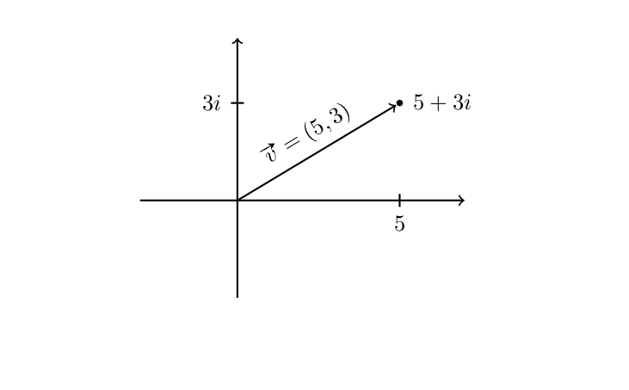
Complex numbers
Complex numbers are an extension of the real numbers with a new unit, the imaginary unit, noted i.
A complex number is usually written as a + bi (for a, b ∈ R) and we can interpret it geometrically as point (a, b) in the two-dimensional plane, or as a vector with components v = (a, b).
Andalus Division

Slide 7
Points and Vectors
    Complex numbers
        Basic operations
        Polar form
        Multiplication
    Point representation
        With a custom structure
        With the C++ complex structure
Andalus Division

Slide 8
Basic operations
(a + bi) + (c + di) = (a + c) + (b + d)i (addition)
(a + bi) − (c + di) = (a − c) + (b − d)i (subtraction)
k(a + bi) = (ka) + (kb)i (multiplication by scalar)
Andalus Division

Slide 9
Points and Vectors
    Complex numbers
        Basic operations
        Polar form
        Multiplication
    Point representation
        With a custom structure
        With the C++ complex structure
Andalus Division

Slide 10
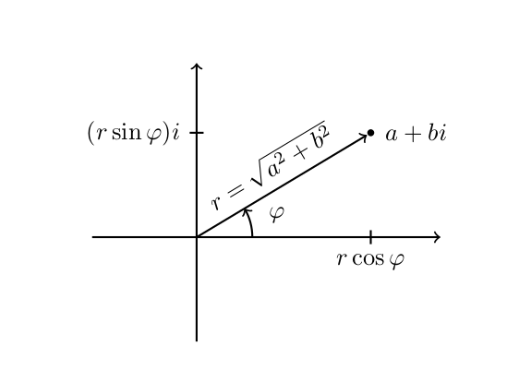
Polar form
For a given complex number a + bi, we can compute its polar form as
      r = |a + bi| = a² + b²
      φ = arg(a + bi) = atan2(b, a)
      r cos φ + (r sin φ)i = r(cos φ + i sin φ) =: r cis φ
Andalus Division

Slide 11
Points and Vectors
    Complex numbers
        Basic operations
        Polar form
        Multiplication
    Point representation
        With a custom structure
        With the C++ complex structure
Andalus Division

Slide 12
Multiplication
Complex multiplication is easiest to understand using the polar form.
(r₁ cis φ₁ ) ∗ (r₂ cis φ₂ ) = (r₁r₂ ) cis(φ₁ + φ₂)
(a + bi) ∗ (c + di) = ac + a(di) + (bi)c + (bi)(di)
              = ac + adi + bci + (bd)i 2
              = ac + (ad + bc)i + (bd)(−1)
              = (ac − bd) + (ad + bc)i
Andalus Division

Slide 13
Points and Vectors
    Complex numbers
        Basic operations
        Polar form
        Multiplication
    Point representation
        With a custom structure
        With the C++ complex structure
Andalus Division
Andalus Division

Slide 14
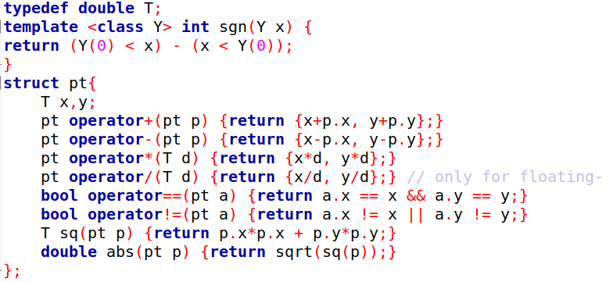
With a custom structure
Andalus Division

Slide 15
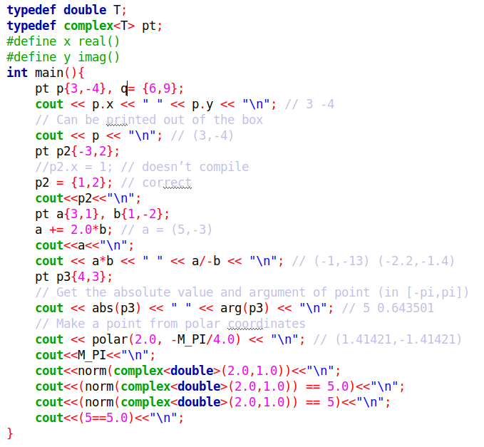
With the C++ complex structure
Andalus Division

Slide 16
Topics
    Points and Vectors
    Transformations
    Products and angles
    Lines
    Segments
    Polygons
    Circles
Andalus Division

Slide 17
Transformations
  Translation
  Scaling
  Rotation
Andalus Division

Slide 18
Transformations
  Translation
  Scaling
  Rotation
Andalus Division

Slide 19
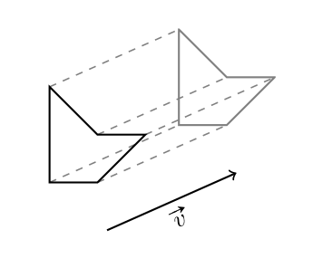
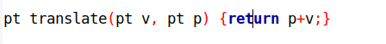
Translation
To translate an object by a vector v , we simply need to add v to every
point in the object. The corresponding function is f (p) = p+ v with v ∈ C.
Andalus Division

Slide 20
Transformations
  Translation
  Scaling
  Rotation
Andalus Division

Slide 21
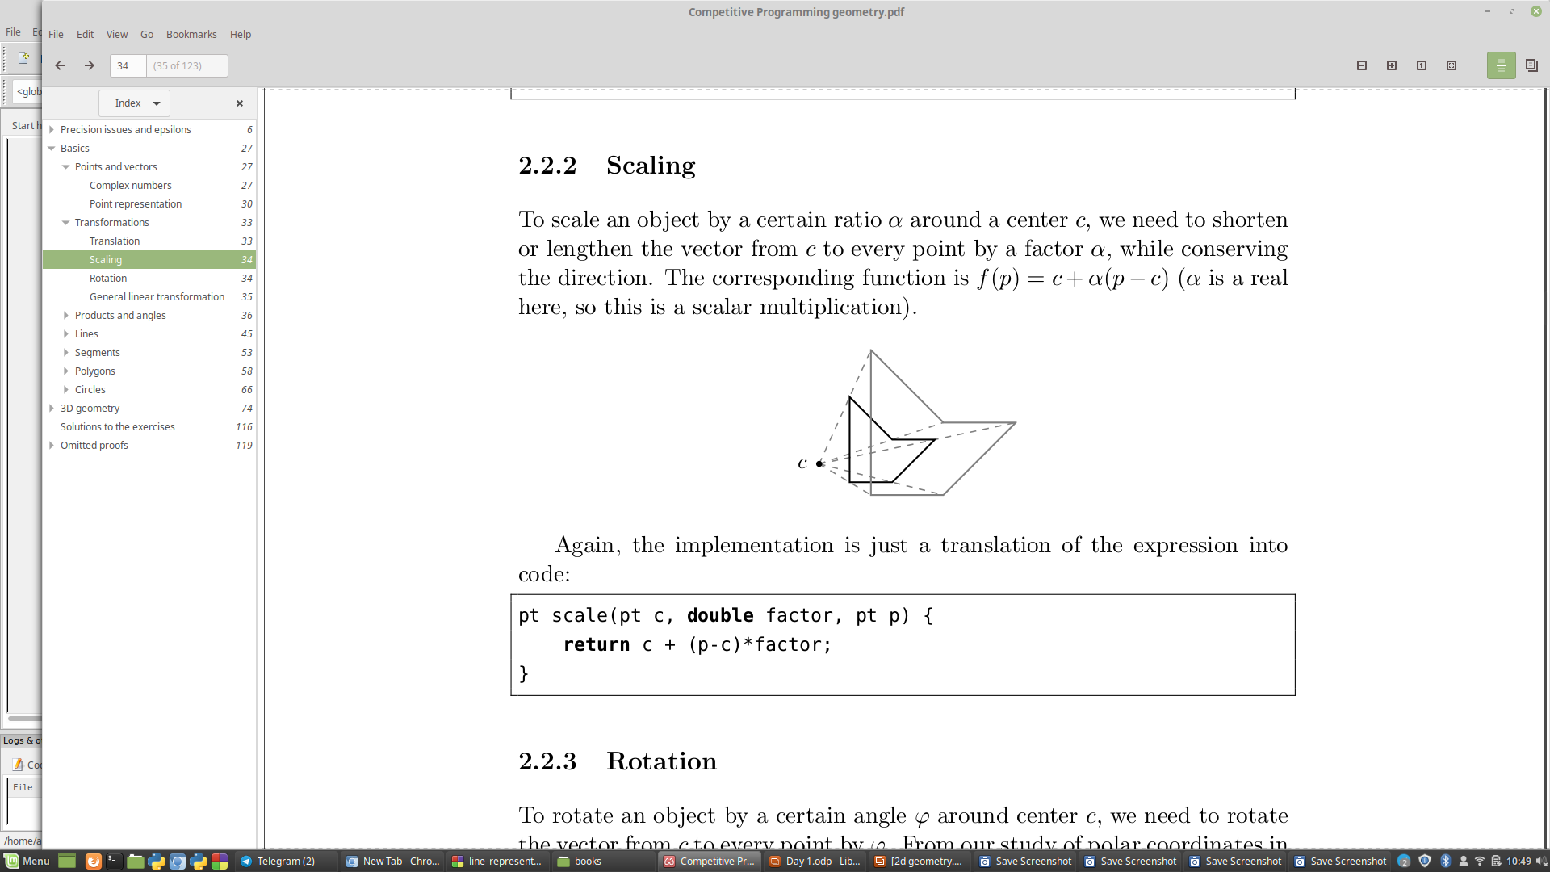
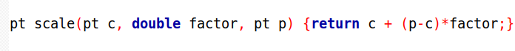
Scaling
To scale an object by a certain ratio α around a center c, we need to shorten or lengthen the vector from c to every point by a factor α, while conserving the direction.
The corresponding function is f (p) = c + α(p − c) (α is a real here, so this is a scalar multiplication)
v
Andalus Division

Slide 22
Transformations
  Translation
  Scaling
  Rotation
Andalus Division

Slide 23
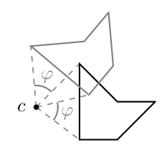
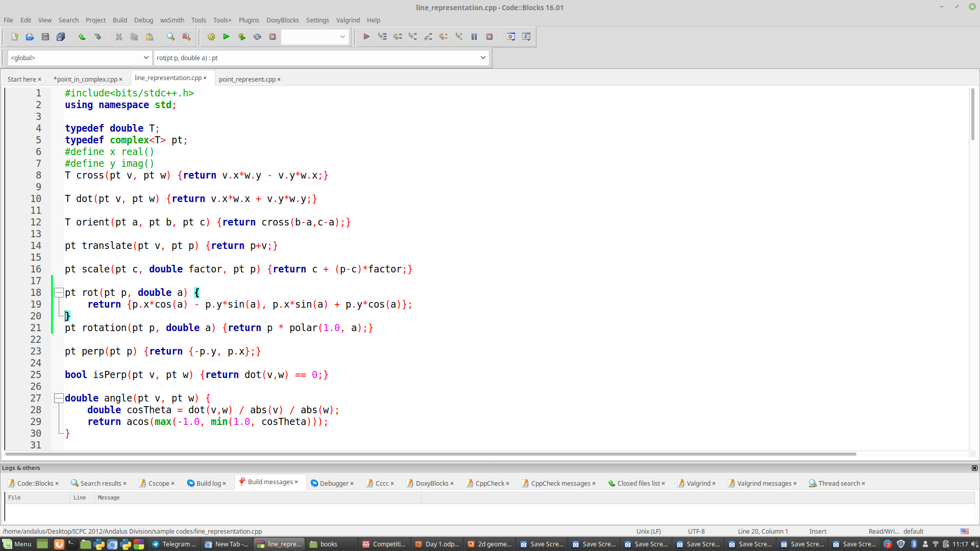
Rotation
To rotate an object by a certain angle φ around center c, we need to rotate the vector from c to every point by φ.
The corresponding function is f (p) = c + cis φ ∗ (p − c).
(x + yi) ∗ cis φ = (x + yi) ∗ (cos φ + i sin φ)
= (x cos φ − y sin φ) + (x sin φ + y cos φ)i
Andalus Division

Slide 24

Rotation
And among those, we will use the rotation by 90◦ quite often:
(x + yi) ∗ cis(90◦) = (x + yi) ∗ (cos(90◦) + i sin(90◦))
= (x + yi) ∗ i = −y + xi
It works fine with integer coordinates, which is very useful:
Andalus Division

Slide 25
Topics
    Points and Vectors
    Transformations
    Products and angles
    Lines
    Segments
    Polygons
    Circles
Andalus Division
Andalus Division
Andalus Division

Slide 26
Products and angles
  dot product
  cross product
  orientation
Andalus Division

Slide 27
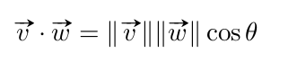
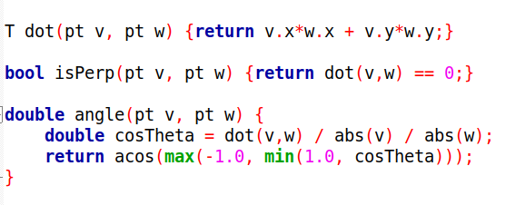
dot product
The dot product v · w of two vectors v and w can be seen as a measure of how similar their directions are. It is defined as
Andalus Division

Slide 28
Products and angles
  dot product
  cross product
  orientation
Andalus Division

Slide 29
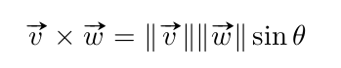
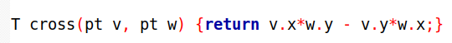
Cross product
The cross product v × w of two vectors v and w can be seen as a measure of how perpendicular they are. It is defined in 2D as
Andalus Division

Slide 30
Products and angles
  dot product
  cross product
  orientation
Andalus Division

Slide 31
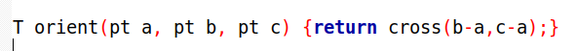
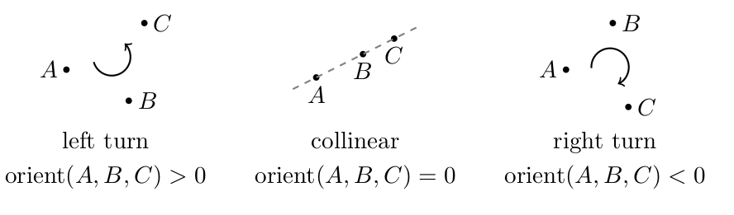
orientation
One of the main uses of cross product is in determining the relative position
of points and other objects.
For this, we define the function orient(A,B,C)=AB×AC. It is positive if C is on the left side of AB, negative on the right side, and zero if C is on the line containing AB.
It is straightforward to implement:
Andalus Division
Andalus Division

Slide 32
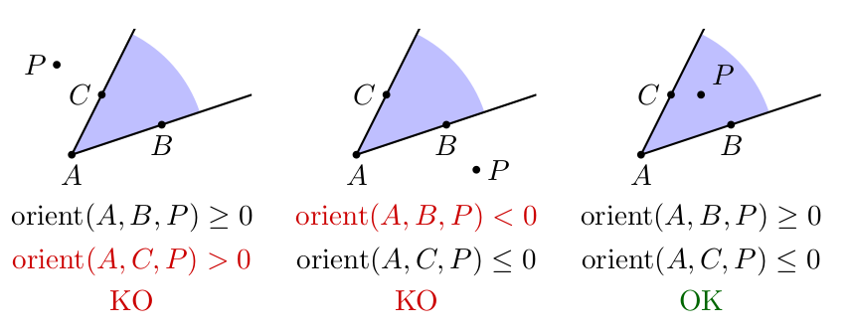
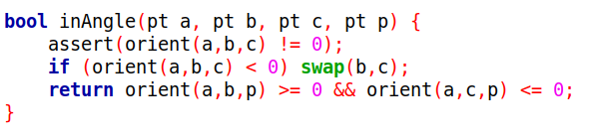
inAngle
Andalus Division

Slide 33
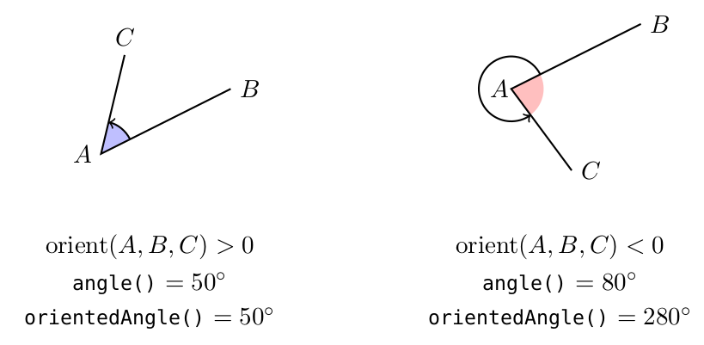
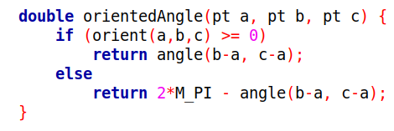
Oriented angle
Andalus Division

Slide 34
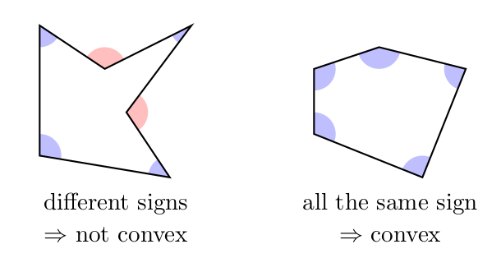
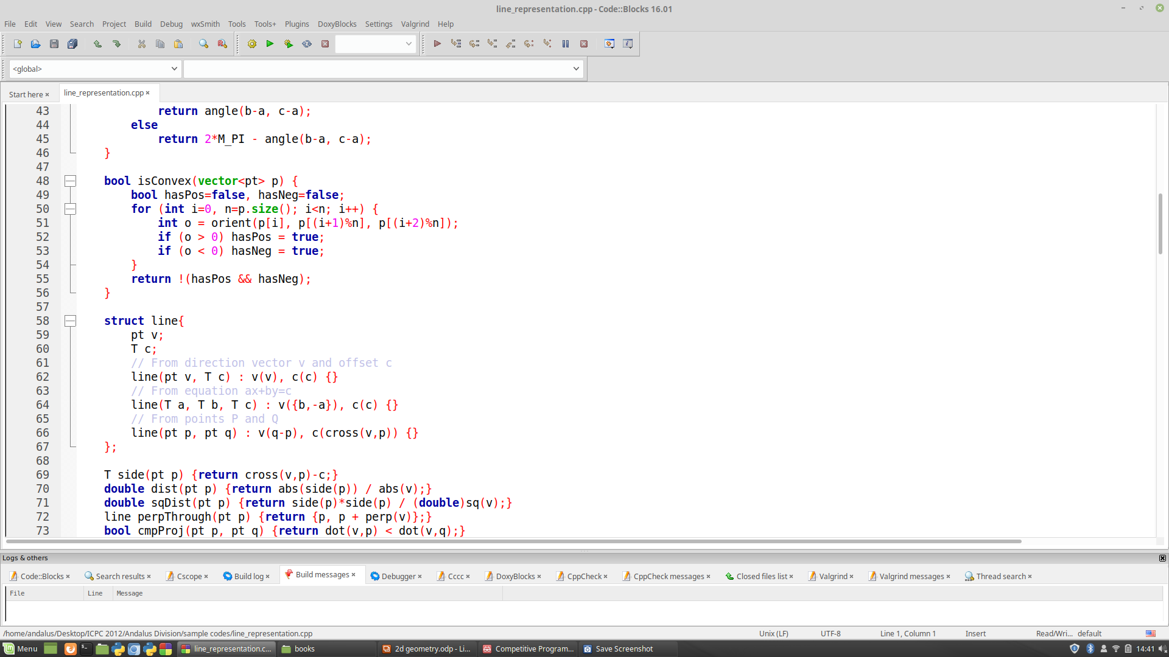
Convex
Yet another use case is checking if a polygon P₁ · · · P_{n} is convex: we compute the
n orientations of three consecutive vertices orient(P_{i}, P_{i+1} , P_{i+2} ), wrapping around from
n to 1 when necessary.
The polygon is convex if they are all ≥ 0 or all ≤ 0, depending on the order in which the vertices are given.
Andalus Division

Slide 35
Topics
    Points and Vectors
    Transformations
    Products and angles
    Lines
    Segments
    Polygons
    Circles
Andalus Division

Slide 36
Lines
  Line representation
  Side and distance
  Perpendicular throught a point
  Translating a line
  Line intersection
  Orthogonal projection and reflection
Andalus Division

Slide 37
Lines
  Line representation
  Side and distance
  Perpendicular throught a point
  Translating a line
  Line intersection
  Orthogonal projection and reflection
Andalus Division

Slide 38
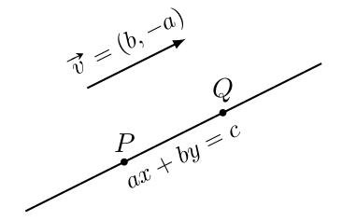
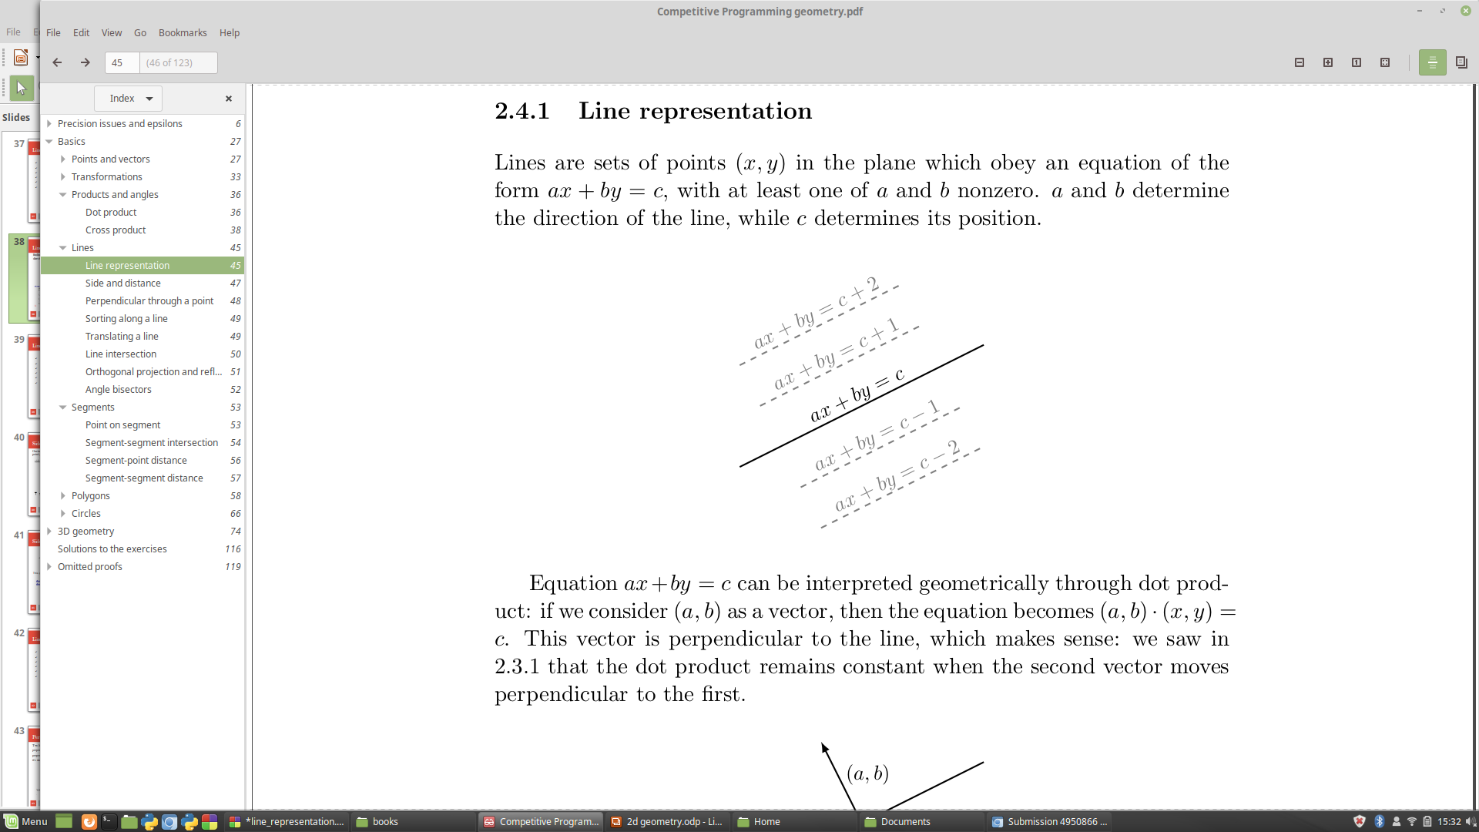
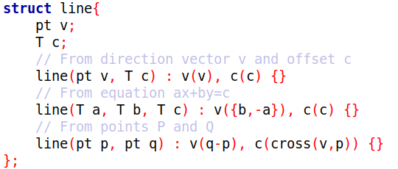
Line representation
finding the equation of a line going through two points P and Q is easy: define the direction vector v=(b, −a)=PQ, then find c as v × P .
Andalus Division

Slide 39
Lines
  Line representation
  Side and distance
  Perpendicular throught a point
  Translating a line
  Line intersection
  Orthogonal projection and reflection
Andalus Division

Slide 40
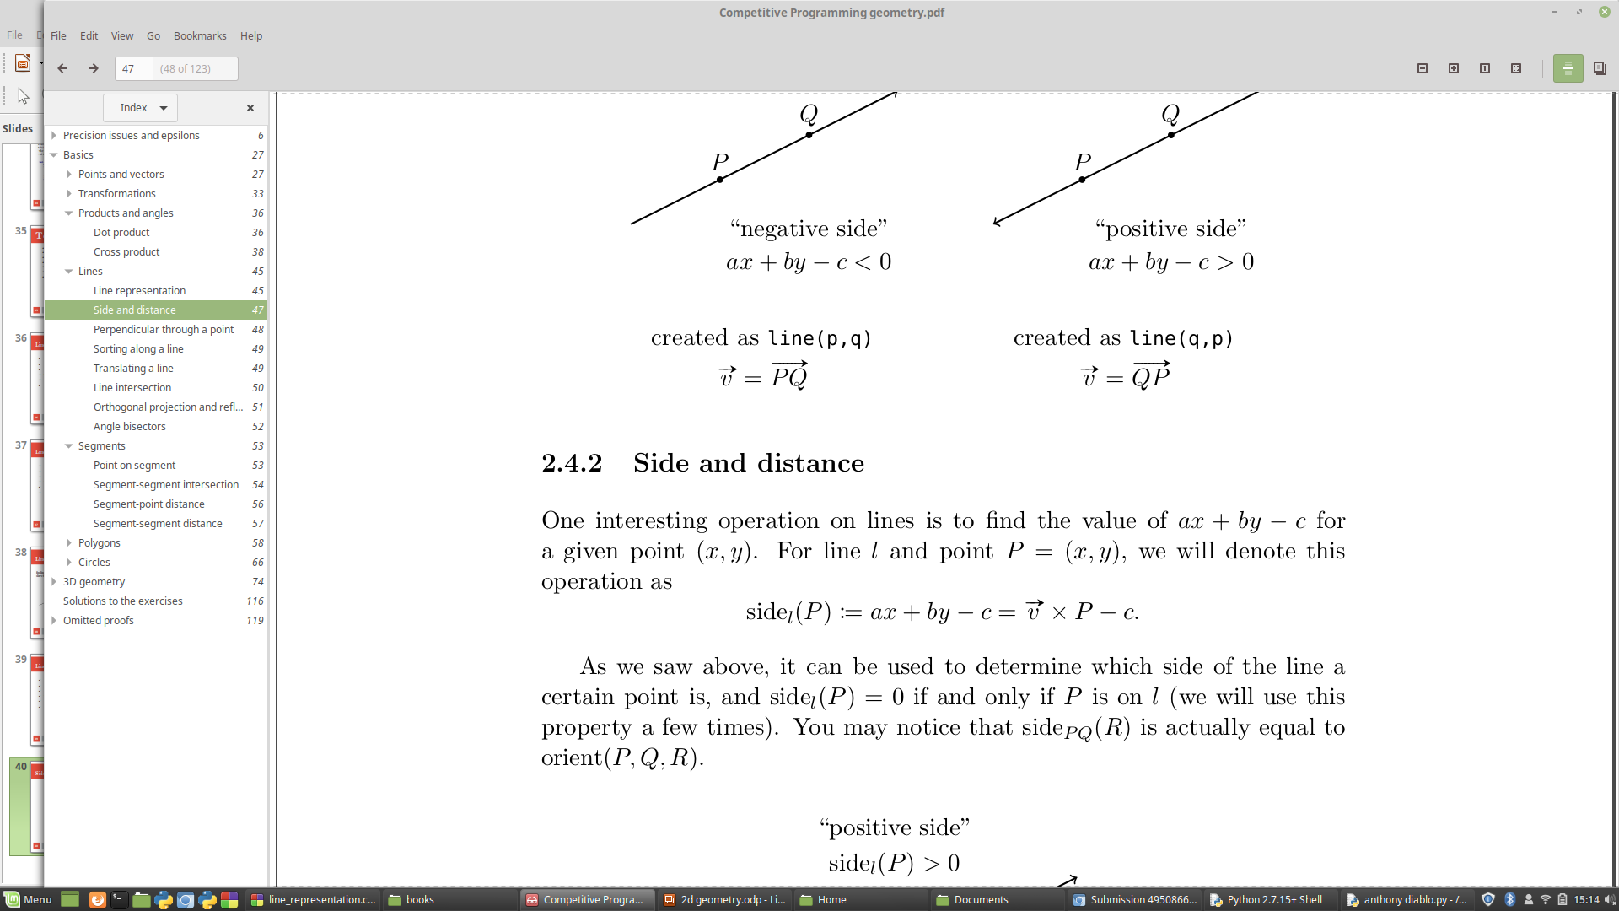
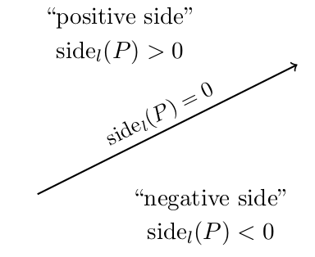
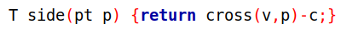
Side and distance
One interesting operation on lines is to find the value of ax + by − c for a given point (x, y). For line l and point P=(x, y), we will denote this operation as
Andalus Division
Andalus Division
Andalus Division
Andalus Division
Andalus Division
Andalus Division

Slide 41
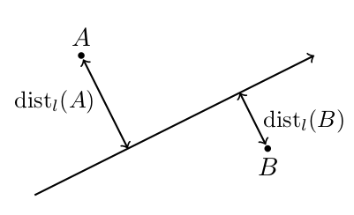
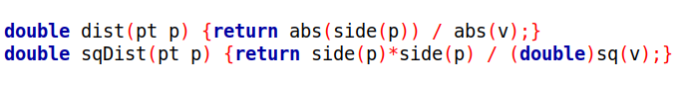
Side and distance
This gives an easy implementation of distance:
Andalus Division

Slide 42
Lines
  Line representation
  Side and distance
  Perpendicular throught a point
  Translating a line
  Line intersection
  Orthogonal projection and reflection
Andalus Division

Slide 43
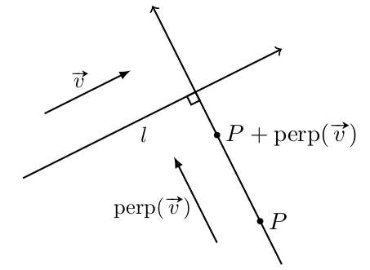
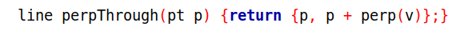
Perpendicular throught the point
Two lines are perpendicular if and only if their direction vectors are
perpendicular. Let’s say we have a line l of direction vector v . To find a line
perpendicular to line l and which goes through a certain point P.
it’s simpler to just compute it as the line from P to P + perp(v).
Andalus Division

Slide 44
Lines
  Line representation
  Side and distance
  Perpendicular throught a point
  Translating a line
  Line intersection
  Orthogonal projection and reflection
Andalus Division

Slide 45
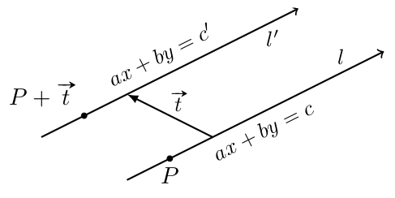
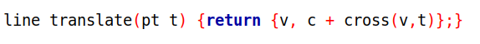
Translating a line
If we want to translate a line l by vector t , the direction vector v remains the same but we have to adapt c.
which allows us to find c’:
c’=v × (P + t ) = v × P + v × t = c + v × t
Andalus Division

Slide 46
Lines
  Line representation
  Side and distance
  Perpendicular throught a point
  Translating a line
  Line intersection
  Orthogonal projection and reflection
Andalus Division

Slide 47
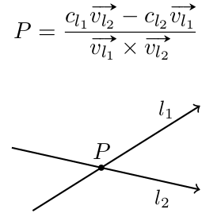
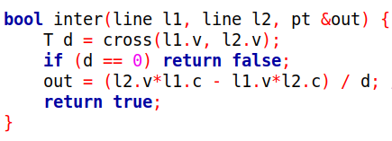
Line intersection
There is a unique intersection point between two lines l₁ and l₂ if and only
if v_{l1} × v _{l2} != 0.
Andalus Division

Slide 48
Lines
  Line representation
  Side and distance
  Perpendicular throught a point
  Translating a line
  Line intersection
  Orthogonal projection and reflection
Andalus Division

Slide 49
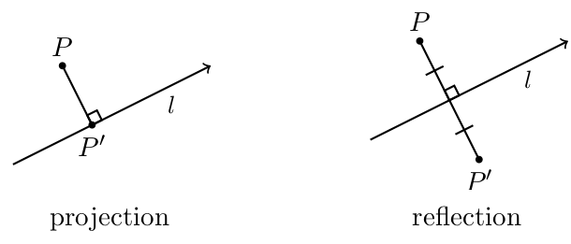
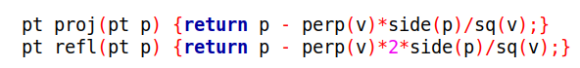
Orthogonal projection and reflection
The orthogonal projection of a point P on a line l is the point on l that is closest to P.
The reflection of point P by line l is the point on the other side of l that is at the same distance and has the same orthogonal projection.
Andalus Division

Slide 50
Topics
    Points and Vectors
    Transformations
    Products and angles
    Lines
    Segments
    Polygons
    Circles
Andalus Division

Slide 51
Segments
  Point on Segment
  Segment-point distance
  Segment-segment distance
Andalus Division

Slide 52
Segments
  Point on Segment
  Segment-point distance
  Segment-segment distance
Andalus Division

Slide 53
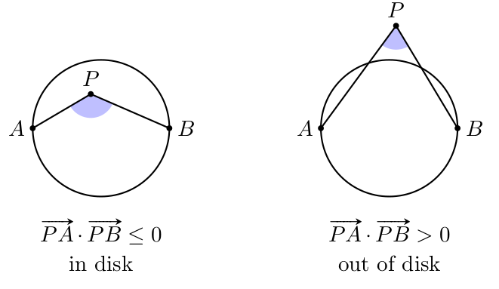
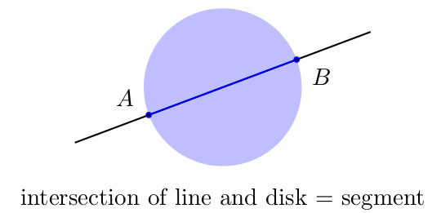
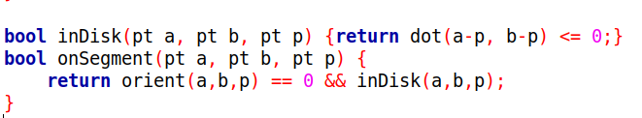
Point on segment
Andalus Division

Slide 54
Segments
  Point on Segment
  Segment-point distance
  Segment-segment distance
Andalus Division

Slide 55
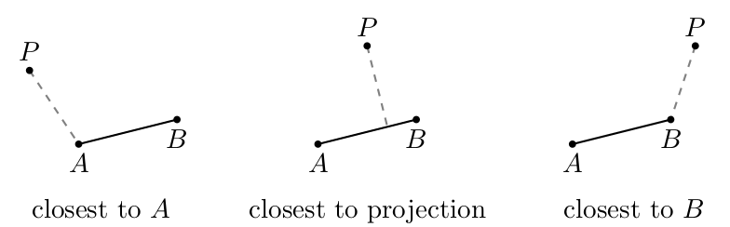
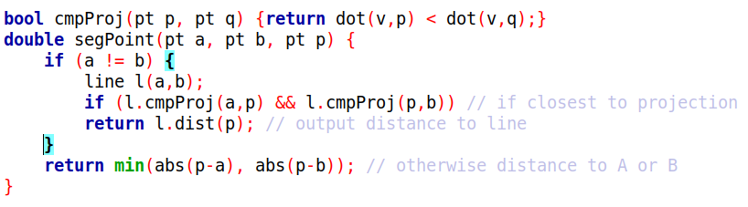
Segment-point distance
To check this, we can use the cmpProj() method in line .
Andalus Division

Slide 56
Segments
  Point on Segment
  Segment-point distance
  Segment-segment distance
Andalus Division

Slide 57
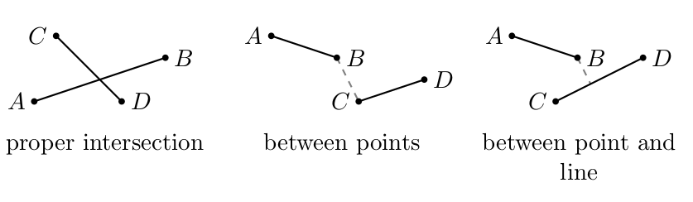
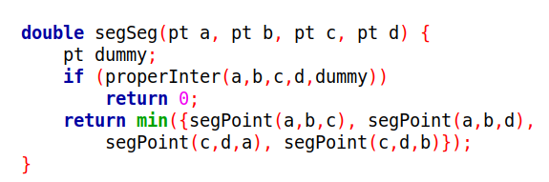
Segment-segment distance
Andalus Division

Slide 58
Topics
    Points and Vectors
    Transformations
    Products and angles
    Lines
    Segments
    Polygons
    Circles
Andalus Division
Andalus Division

Slide 59
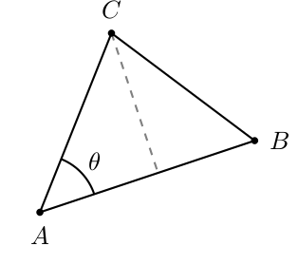
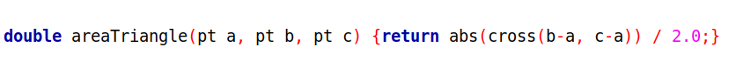
Triangle area
To compute the area of a polygon, it is useful to first consider the area of a triangle ABC.
(|AB ||AC | sin θ )/2 = (|AB × AC |)/2
Andalus Division

Slide 60
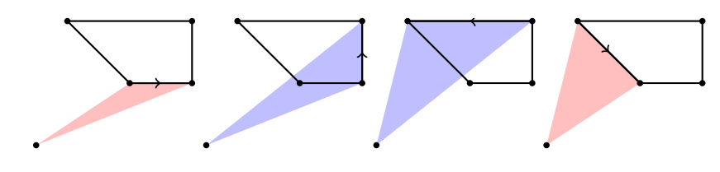
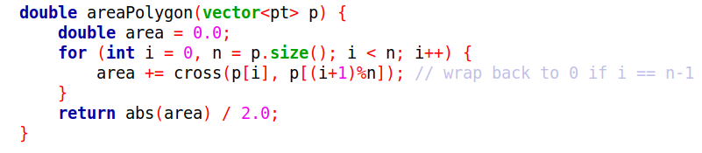
Polygon area
Let’s take an arbitrary reference point O. Let’s consider the vertices of ABCD in order, and for every pair of consecutive points P₁ , P₂ , we’ll add the area of OP₁P₂ to the total if P₁P₂ goes counter-clockwise around O, and subtract it otherwise. Additions are marked in blue and subtractions in red.
Andalus Division

Slide 61
Topics
    Points and Vectors
    Transformations
    Products and angles
    Lines
    Segments
    Polygons
    Circles
Andalus Division
Andalus Division

Slide 62
Circle
Defining circle
Circumcircle
Circle-line intersection
Circle-circle intersection
Tangent line
Andalus Division
Andalus Division

Slide 63
Circle
Defining circle
Circumcircle
Circle-line intersection
Circle-circle intersection
Tangent line
Andalus Division
Andalus Division

Slide 64
Defining a circle
Circle (O, r) is the set of points at distance exactly r from a point
O =(x₀ , y₀).
        We can also define it by equation
        (x − x₀)² + (y − y₀)² = r²
or parametrically as the set of all points
        (x₀ + rcosθ, y₀ + rsinθ)
with θ in [0, 2π)
Andalus Division
Andalus Division

Slide 65
Circle
Defining circle
Circumcircle
Circle-line intersection
Circle-circle intersection
Tangent line
Andalus Division
Andalus Division

Slide 66
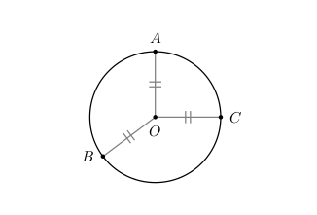
Circumcircle
The circumcircle of a triangle ABC is the circle that passes through all
three points A, B and C.
It is undefined if A, B, C are aligned, and unique otherwise. We can compute its center O this way:
Andalus Division
Andalus Division

Slide 67
Circumcircle
pt circumCenter(pt a, pt b, pt c) {
b = b-a, c = c-a; // consider coordinates relative to A
assert(cross(b,c) != 0);
// no circumcircle if A,B,C aligned
return a + perp(b*sq(c) - c*sq(b))/cross(b,c)/2;
}
Andalus Division
Andalus Division

Slide 68
Circle
Defining circle
Circumcircle
Circle-line intersection
Circle-circle intersection
Tangent line
Andalus Division
Andalus Division

